Slide 1
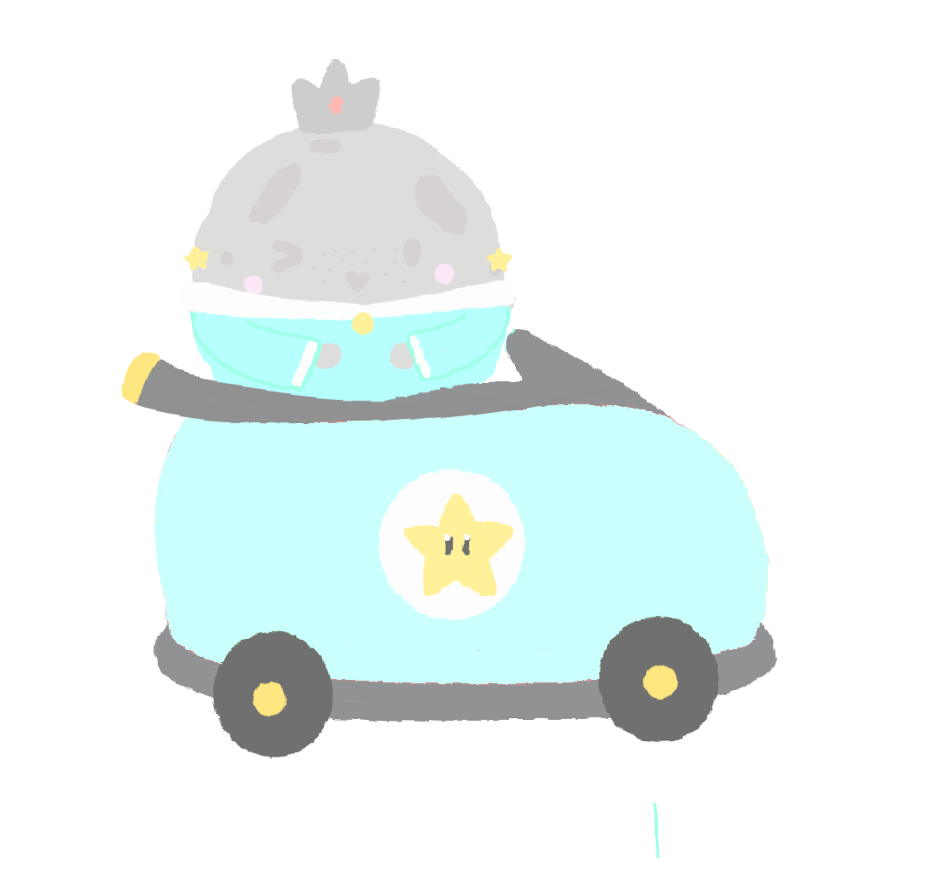
Engaging Members
Region Training Conference
Ella Trinh, Club President
Michelle Olden, Club President
Notes:
‹#›

Slide 2
What are ways to keep members engaged?

Slide 3
Ways to Engage
Spirit causes spirit
  Break the barrier
    It is ok to feel uncomfortable
    Depend on relatability
    Cheering
  Showing interest will cause others to show interest
    Influenced by peers
  Creating a welcoming environment is key

Slide 4
Ways to Engage
Use interactive activities
  Icebreakers
    Fun games to get to know others
    To break the barrier
  Group working activities
    Like icebreakers
    Has people working together
    Creates bonds on cognitive level

Slide 5
Ways to Engage
Use interactive activities
  Volunteering events
    Volunteer with other members
    Stay with your club
  Socials
    Includes icebreakers, opportunity events, opportunity to directly connect
    Outside of school environment

Slide 6
Engaging Through Social Media
Don’t just repost, make it your own
  Often just a picture or video
  Create an experience that is yours
    GIFs, stickers, captions, drawings, custom fonts, music features, etc.
  Captions are effective
  Try your best to make it accessible

Slide 7
Engaging Through Social Media
Reach out to others
  Message other members
    Check awareness
  Not all the time
  Consider what the audience may want
Interact with other members
  Pen pals, those are Fall Rally
  Take pictures with others and tag them

Slide 8
Engaging Through Social Media
Interact with other members (cont.)
  Fall Rally Social Media reminder
  Be mindful of SafeKey
    Maintain a clean image of Key Club and its members

Slide 9
Icebreakers
Bang is no longer permitted
  Popular name game
  Due to insensitive nature and current events

Slide 10
Icebreakers
Different icebreakers
  Name/get to know you games
  Movement games
  Creation/thinking games

Slide 11
Icebreakers
Name/Get to know you game
  I like…
    Name two to three things you like about that person
  Pass the box/hot potato
    Goal: to not get the box or “hot potato”
    Play music, when music stops, person with box has to open it and introduce themselves

Slide 12
Icebreakers
Name/Get to know you game
  Soulmate
    Goal: to try to find someone similar to you
    One person lists qualities to try to find their soulmate

Slide 13
Icebreakers
Movement games
  Salt and Pepper or Three People in a Boat
    Goal: to be one of the last people in a group
    Portray groups or people by a command of words
      Salt and Pepper = two people together
      Three people in a boat = three people rowing boat
      Five people around a campfire = five people warming hands around a campfire

Slide 14
Icebreakers
Movement games
  Heads Up Seven Up
    Goal: to be the last person participating
    People sit with their thumbs up
    Seven people are chosen to choose the new seven
  Simon Says: Group Edition
    Goal: to be the last person participating
    Simon Says with more movement (similar to Salt and Pepper)

Slide 15
Icebreakers
Movement games
  The Wright Family
    Goal: to do the activity as correctly and efficiently as possible
    Each person holds an object and passes it left or right when they hear the words left or right
    https://www.cdc.gov/healthyschools/shi/pdf/training-manual/WrightFamily.pdf

Slide 16
Icebreakers
Creation/Thinking games
  Psychiatrist
    Goal: the psychiatrist has to guess what the common symptom
    People gather together to create a common symptom that the psychiatrist has to guess
      Ex: every time someone laughs, we snap our fingers

Slide 17
Icebreakers
Creation/Thinking games
  Concentration
    Goal: to be the last person participating
    People are in a circle, hands on top of each others as if passing a ball
    No hesitation, off the bat thinking
    “Concentration, concentration, no repeats or hesitations, subject/category/topic is…”

Slide 18
Icebreakers
Creation/Thinking games
  Think fast
    Goal: be the last person participating
    Around the world style
    Spelling bee + trivia questions

Slide 19
Questions?
Comments?
Concerns?
Further Questions, please contact:
Michelle Olden nwcta.president@gmail.com
Ella Trinh caslvkeyclubpres@gmail.com
Instagram: @ellaatrinh

